Slide 1
Alexandra Primary School
Year 4
Tuesday 19th September 2023

Slide 2

Our Vision:
Children at Alexandra have high aspirations to be able to perform and succeed at school and beyond
We encourage all children to:
Aspire to be successful learners who enjoy learning;
Perform as well as they can, make progress and achieve and become confident individuals who are able to live safe and fulfilling lives;
Succeed as responsible citizens who make a positive contribution to society.

Slide 3
Who’s who in Year 4?
Teachers
4C – Mr Cuell
4P – Miss Padda
4S – Miss Stopp
Teaching Assistants
Ms Prothero
Ms Bavin
Ms Preeti

Slide 4
Our Topics This Year
Autumn – Frozen Kingdom
Spring – Orient Express
Summer – Romans on the Rampage
Please see the Curriculum overview for Year 4 for the skills and objectives in detail, which will be available to see on our website.
Our weekly overview, which will be available on our website and on Google Classroom, will also contain this information in detail.

Slide 5
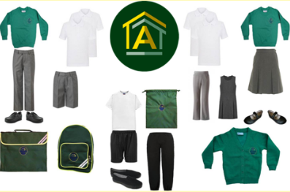
Year 4 Routines and Expectations
Doors open at 8:40am. Pick up is at 3:30pm
Reading record (pupil planner) in every day
Uniform – labelled clearly (*pre-loved uniforms available to buy from the office)
Provide healthy (fruit) snack if wanted
Healthy packed lunch/an idea of what to choose for school dinners
Homework (set on Monday. Where applicable, due in the following Monday each week). Children should know their username and password for each school app and be able to log in to their online apps independently at this stage.

Slide 6
Reading at school
At Alexandra Primary School we see reading as an integral part of the school curriculum that impacts on all learning.
We use children’s literature to support and develop high quality learning and a whole school love of reading.
We value the importance of being a confident reader and want children to enjoy reading a wide range of different books.
Children develop the skills for reading through the teaching of the ‘8 reading strategies’. We focus on one of the strategies each week, with the teacher clearly talking about and modelling the skill so that children learn how to be more active readers.

Slide 7















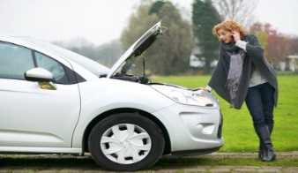
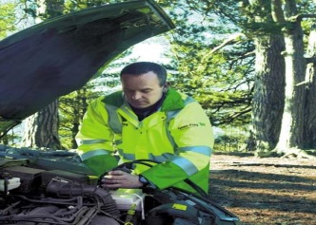

Strategies to help us understand and enjoy reading, as we read we ……..
book to self
book to world knowledge
book to book
Use our background
knowledge and
connect to text
Ask questions,
predict, I wonder…
Visualise
Fotolia.com
I think I’ve broken down
I’ve broken down but I have a plan to fix it
Watch out for VIP words/ phrases/ideas
…and put together to build GIST
Notice
breakdown…
and repair it

Slide 8
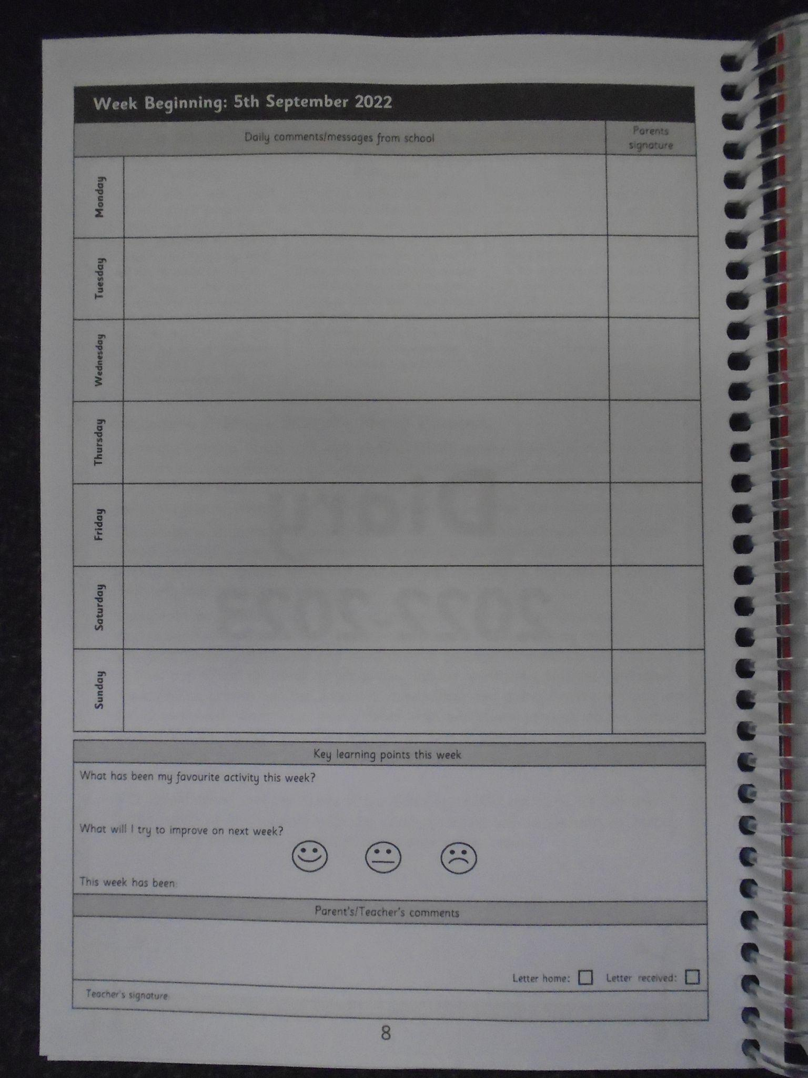
Reading at home
Children are expected to read each day/night at home (for 20 minutes or so) and parents are asked to comment in their diaries.
Please listen to your child read each day. Write the name of the book, the chapter or pages read and a short comment about your child’s reading and understanding of the text.
When you listen to your child read, it is very important that you ask your child questions about what they have read as this is what will demonstrate if they have understood what they have read.
Please keep your child’s books in their book bag and return them to school daily.
If your child reads other books at home, please feel free to write the name of this book in your pupil planner.
In Year 4, we still use Bug Club, where children can answer questions about texts which have been set to test their comprehension skills. In addition, we use Reading Plus.

Slide 9
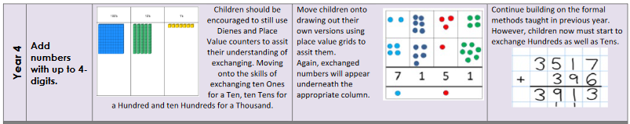
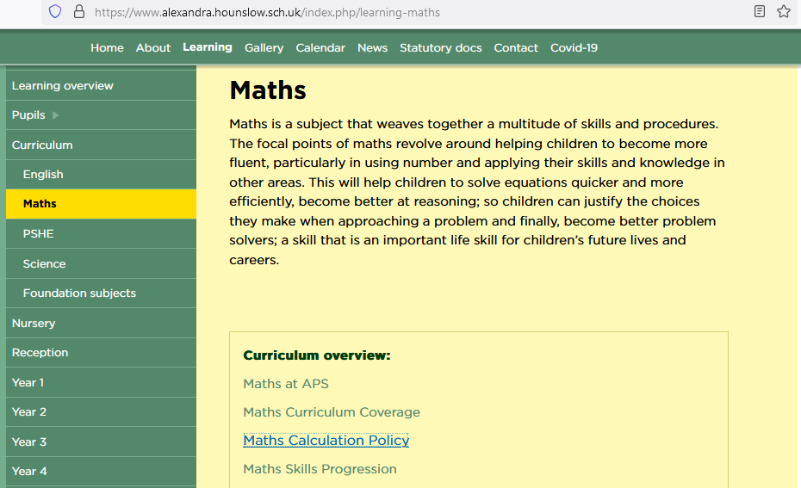
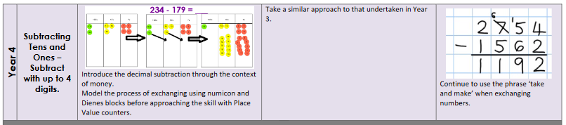
Maths
In Year 4, we focus on becoming more efficient in Mental Maths and in the calculation strategies we use. To ensure clarity, please see the Maths calculation policy on the school’s website to ensure that we are teaching the same strategies at school and at home.

Slide 10
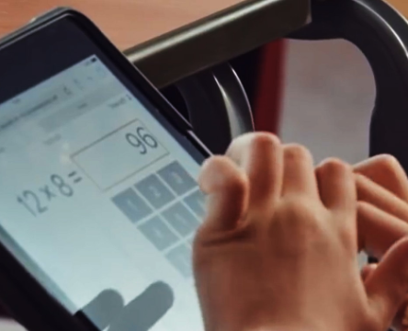

The Multiplication Tables Check is to be taken towards the end of Year 4 to make sure children are meeting the benchmark of memorising their multiplication facts up to 12 x 12 before moving up to Upper Key Stage 2 (Year 5 and Year 6).
Another great practice website is: www.timestables.co.uk
When children have quick recall of their multiplication facts, it allows them to work more efficiently and to apply this knowledge to other concepts in their Maths lessons.

Slide 11

Doodle
Through Doodle we can set:
Maths - A variety of maths tasks linked to recent learning.
Spelling - Linked to recent English lessons and the spelling pattern of the week.
Reading - Focusing on reading comprehension skills.

Slide 12
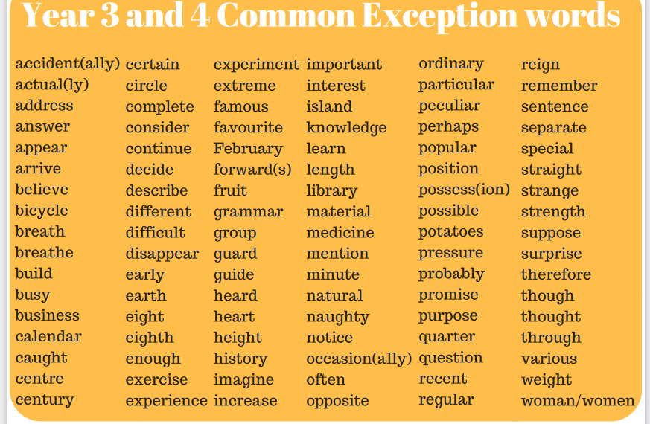
Spelling
Spellings are taught through English lessons and your child will have weekly spelling homework.
We expect children to understand the meaning of the words being learnt as well as the spelling.
The spellings include words from the Year 3/4 common exception word list and we focus on a particular pattern each week.
Your child will have a weekly spelling/dictation test but, before the test, they will have looked at the patterns of the spelling. This way, they are not just learning them for a test.

Slide 13
PE/Swimming
On normal (non-swimming) PE days, your child should wear their school PE kit into school.

Slide 14
PE/Swimming
Each Friday, we ask that you ensure your child brings the following items in a named bag:
Swimming costume/trunks (no bikinis or baggy swim shorts)
Towel
Swimming hat (for girls and boys)
Children are not allowed to wear earrings or any other jewellery in the swimming pool. Every child is expected to go swimming every week. When the weather is cold, they still go swimming. Please make sure your child has the appropriate clothing and a coat. It would also be helpful if you could discuss at home things like, drying properly, looking after their clothes and swim wear and doing their coat up before going outside.

Slide 15
How to contact us:
A member of staff is at the gate every morning. We can pass on messages to your class teacher.
You can write a note in your child’s pupil planner.
You can phone the school office or email at office@alexandra.hounslow.sch.uk
You can email the year 4 team at year4@alexandra.hounslow.sch.uk
Thank you for your time today. We look forward to working with you over the coming year.

